Slide 1
Software-Defined Radio Beamforming
Direction of Arrival (DOA) Analysis

Slide 2
Goals
Beamforming - determine the direction an EM wave is propagating from
Distributed DSP - do something with multiple phones working together
Notes:
\newline
a(t) = \text{ baseband signal}
\newline
s(t) = \text{ modulated signal}
\newline
s(t) = a(t)cos(\omega t)
\newline \newline
x_1(t) = s(t) = a(t)cos(\omega t)
\newline
x_2(t) = s(t-\tau) = a(t-\tau)cos(\omega (t - \tau))

Slide 3
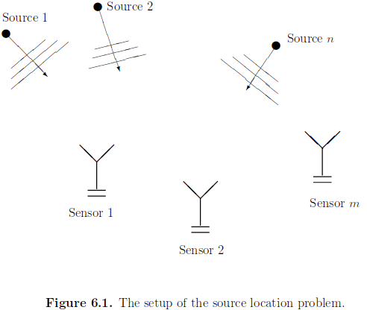
Introduction to Spectral Analysis,
Peter Stoica and Randolph Moses
Notes:
https://www.codecogs.com/latex/eqneditor.php

Slide 4
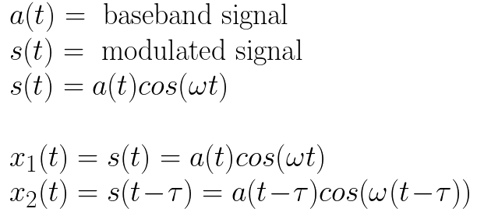
The Source Location Problem
Our incoming signal s(t) is received by two different antennas as x1(t) and x2(t). We’ll call x1(t) our reference, and let x2(t) have a delay represented as Tau.
Notes:
\newline
a(t) = \text{ baseband signal}
\newline
s(t) = \text{ modulated signal}
\newline
s(t) = a(t)cos(\omega t)
\newline \newline
x_1(t) = s(t) = a(t)cos(\omega t)
\newline
x_2(t) = s(t-\tau) = a(t-\tau)cos(\omega (t - \tau))

Slide 5
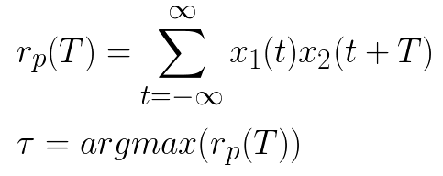
Time Difference Of Arrival
A heuristic approach would be to cross-correlate x1(t) with x2(t) and use the location of the peak to determine Tau directly.
Notes:
\newline
r_p(T) = \displaystyle\sum_{t=-\infty}^{\infty} x_1(t) x_2(t+T)
\newline \newline
\tau = argmax(r_p(T))

Slide 6
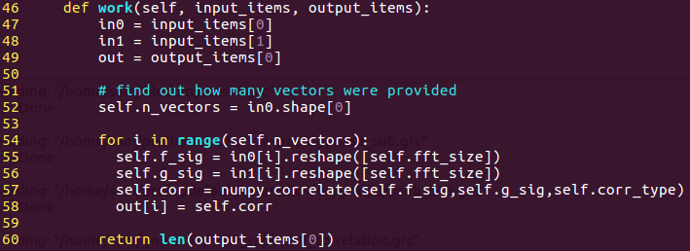
Time Difference Of Arrival - Gnuradio

Slide 7
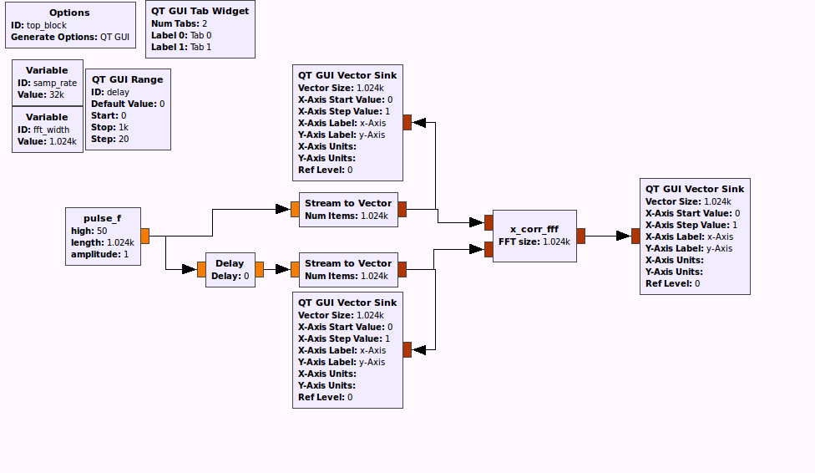

Slide 8
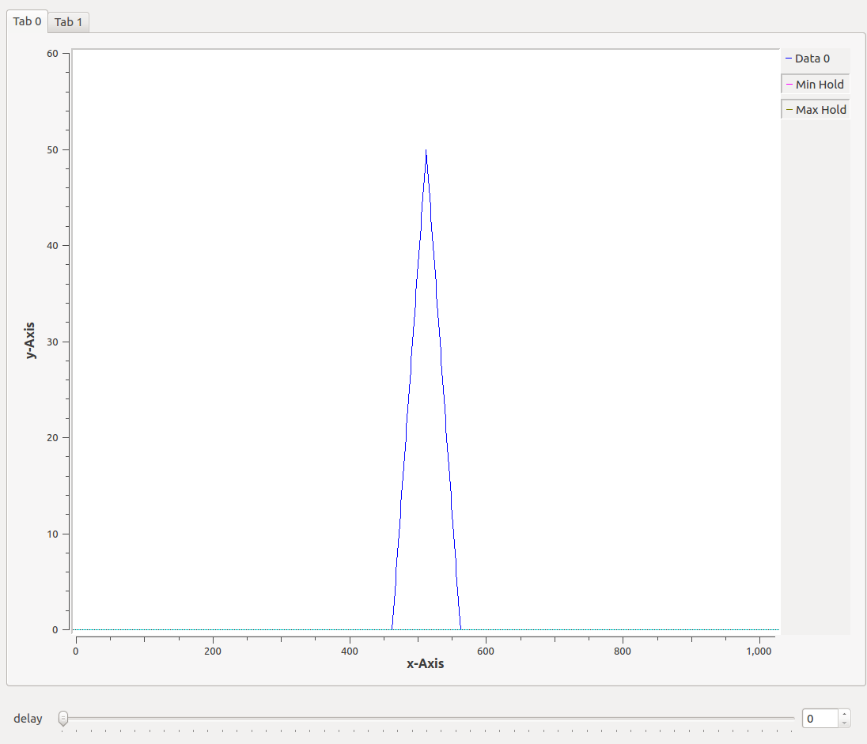
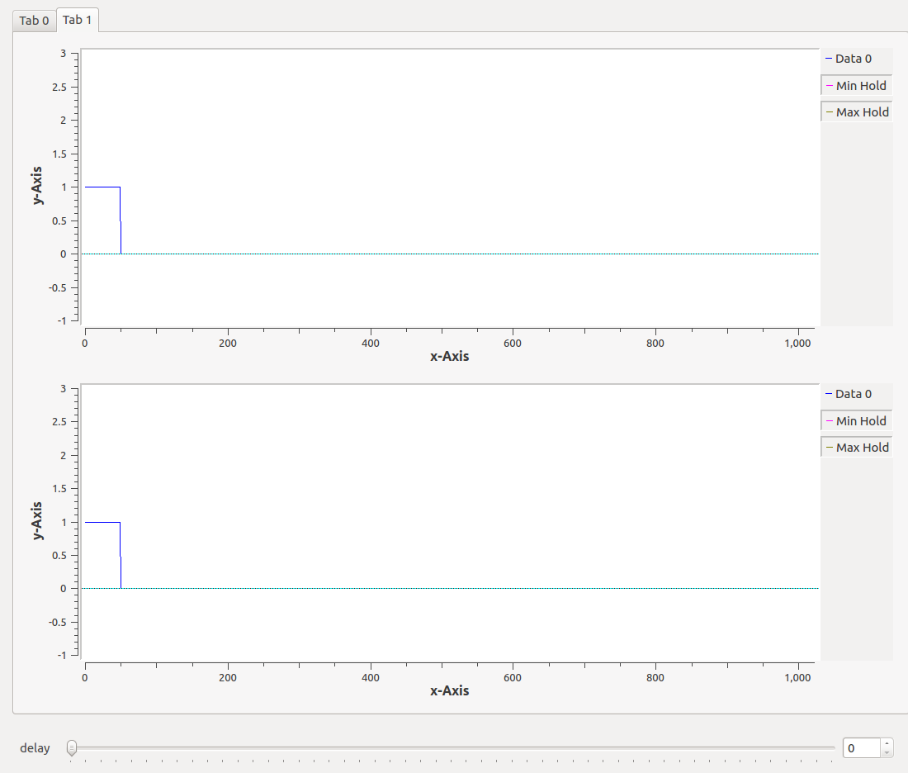
Time Difference Of Arrival - Gnuradio

Slide 9
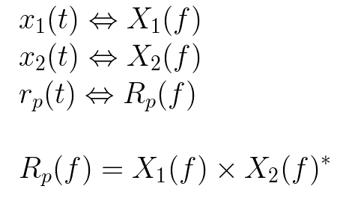
Time Difference Of Arrival
We can reduce the needed number of computations significantly by completing this problem in the frequency domain.
Notes:
\newline
x_1(t)\Leftrightarrow X_1(f)
\newline
x_2(t)\Leftrightarrow X_2(f)
\newline
r_p(t) \Leftrightarrow R_p(f)
\newline \newline
R_p(f) = X_1(f) \times X_2(f)^{\ast}

Slide 10
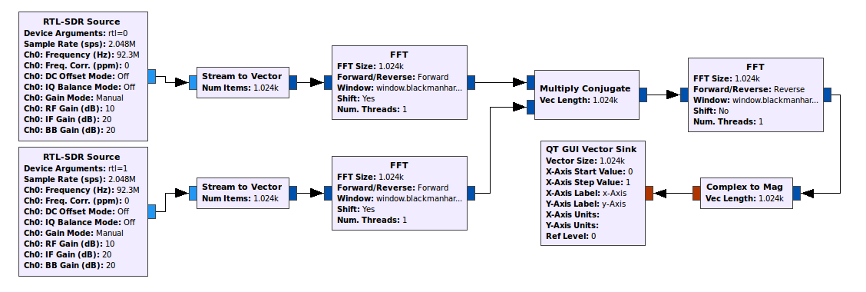
Time Difference Of Arrival - Gnuradio

Slide 11
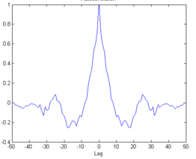
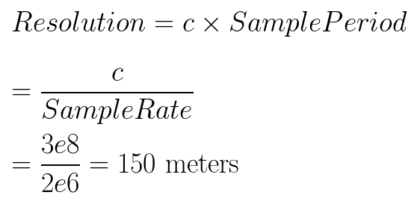
Time Difference Of Arrival
For electromagnetic waves traveling at the speed of light and a sample rate of 2 MHz, this solution is able to resolve differences of
Notes:
\newline
Resolution = c\times Sample Period
\newline \newline
= \frac{c}{Sample Rate}
\newline \newline
= \frac{3e8}{2e6} = 150 \text{ meters}

Slide 12
Time Difference Of Arrival
150 meter resolution does not solve our initial problem, but cross correlation proved to play an important role in calibrations.
Notes:
\newline
Resolution = c\times Sample Period
\newline \newline
= \frac{c}{Sample Rate}
\newline \newline
= \frac{3e8}{2e6} = 150 \text{ meters}

Slide 13
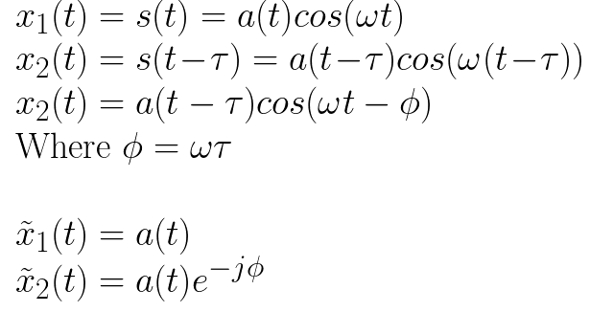
Phase Subtraction
Use the narrow-band assumption to say that the primary difference between the two signals can be represented by a phase shift in the carrier frequency.
Notes:
\newline \newline
x_1(t) = s(t) = a(t)cos(\omega t)
\newline
x_2(t) = s(t-\tau) = a(t-\tau)cos(\omega (t - \tau)) \newline
x_2(t) = a(t-\tau)cos(\omega t - \phi) \newline
\text{Where }\phi = \omega \tau
\newline \newline
\tilde{x}_1(t) = a(t)
\newline
\tilde{x}_2(t) = a(t)e^{-j\phi}

Slide 14
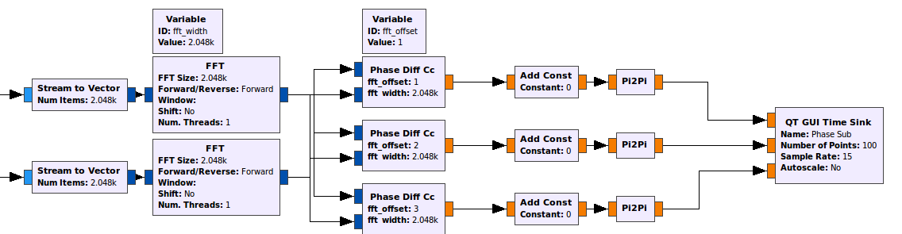
Phase Subtraction
We can find the value of phi directly by taking the FFT of each signal, and finding the difference between the phase values from the same bins.

Slide 15
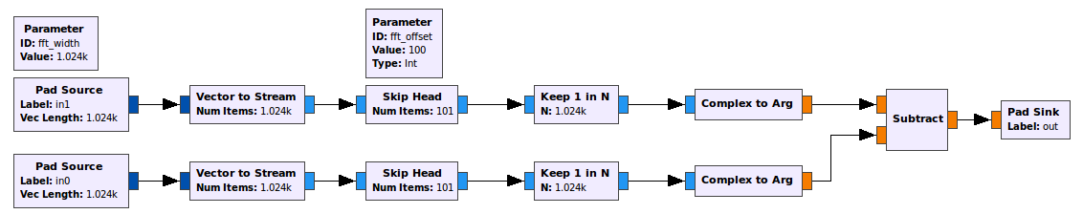
Phase Subtraction
Heir block - Phase Diff cc

Slide 16
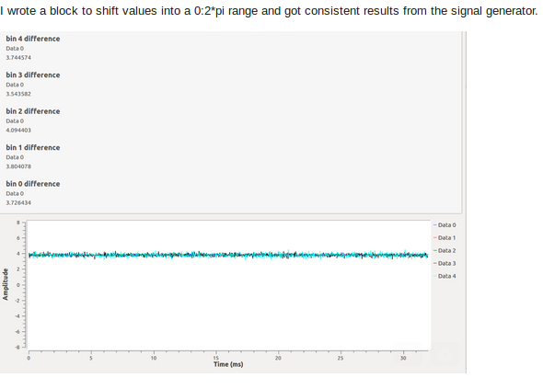
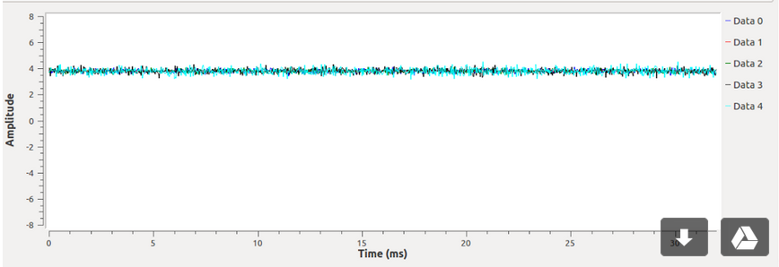
Phase Subtraction

Slide 17
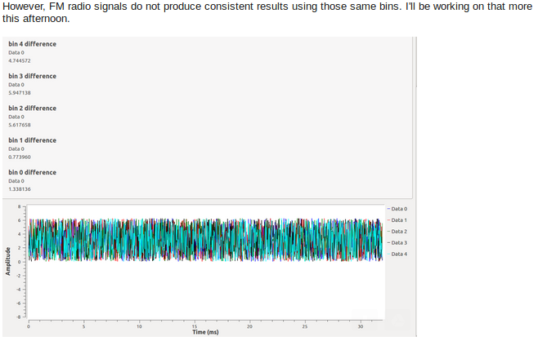
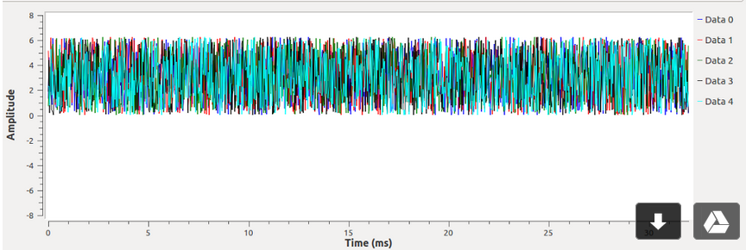
Phase Subtraction

Slide 18
Capon Method
Use the narrow-band assumption to say that the primary difference between the two signals can be represented by a phase shift in the carrier frequency.
Notes:
\newline \newline
x_1(t) = s(t) = a(t)cos(\omega t)
\newline
x_2(t) = s(t-\tau) = a(t-\tau)cos(\omega (t - \tau)) \newline
x_2(t) = a(t-\tau)cos(\omega t - \phi) \newline
\text{Where }\phi = \omega \tau
\newline \newline
\tilde{x}_1(t) = a(t)
\newline
\tilde{x}_2(t) = a(t)e^{-j\phi}

Slide 19
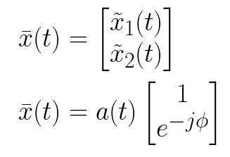
Capon Method
Stack our signals into a vector
Notes:
\newline \newline
\bar{x}(t) = \begin{bmatrix}
\tilde{x}_1(t)
\\
\tilde{x}_2(t)
\end{bmatrix}
\newline \newline
\bar{x}(t) = a(t)\begin{bmatrix}
1
\\
e^{-j\phi}
\end{bmatrix}

Slide 20
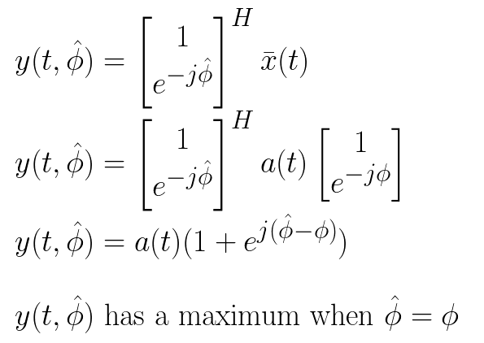
Capon Method
Set up a beam steering vector, and apply it to our signal.
Notes:
\newline \newline
y(t,\hat{\phi}) = \begin{bmatrix}
1
\\
e^{-j\hat{\phi}}
\end{bmatrix} ^{H}
\bar{x}(t)
\newline \newline
y(t,\hat{\phi}) = \begin{bmatrix}
1
\\
e^{-j\hat{\phi}}
\end{bmatrix} ^{H} a(t)\begin{bmatrix}
1
\\
e^{-j\phi}
\end{bmatrix}
\newline \newline
y(t,\hat{\phi}) = a(t) (1+e^{j(\hat{\phi} - \phi)})
\newline \newline
y(t,\hat{\phi}) \text{ has a maximum when } \hat{\phi} = \phi

Slide 21
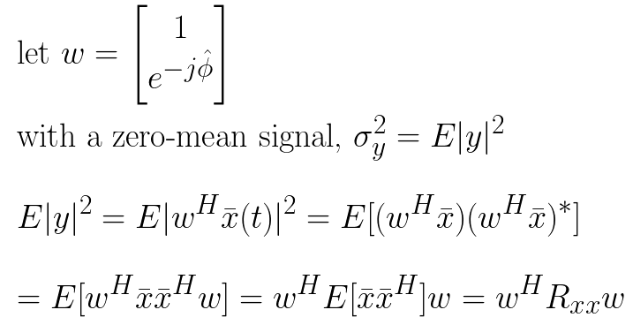
Capon Method
Take the variance of y in order to look at power of the filter output.
Notes:
\newline \newline
\text{let } w = \begin{bmatrix}
1
\\
e^{-j\hat{\phi}}
\end{bmatrix}
\newline \newline
\text{with a zero-mean signal, }\sigma ^{2}_y = E|y|^{2}
\newline \newline
E|y|^{2} = E|w^{H}\bar{x}(t)|^{2} = E[(w^{H}\bar{x})(w^{H}\bar{x})^{\ast}]
\newline \newline
= E[w^{H}\bar{x}\bar{x}^{H}w] = w^{H}E[\bar{x}\bar{x}^{H}]w = w^{H}R_x_xw

Slide 22
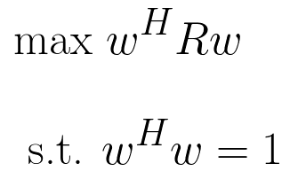
Capon Method
Maximize the power by changing the steering vector with a constraint to limit the gain.
Notes:
\newline \newline
\text{max } w^{H}Rw
\newline \newline
\text{s.t. }w^{H}w = 1

Slide 23
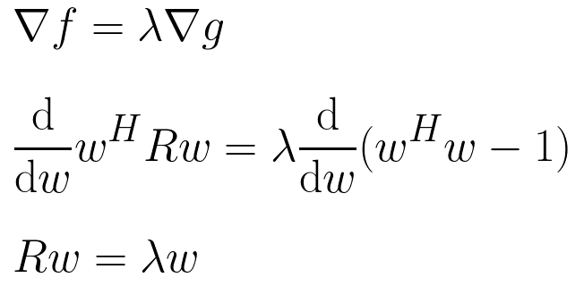
Capon Method
Setup the constrained optimization problem with Lagrange multipliers.
Notes:
\newline \newline
\nabla f = \lambda \nabla g
\newline \newline
\frac{\mathrm{d} }{\mathrm{d} w}w^{H}Rw = \lambda
\frac{\mathrm{d} }{\mathrm{d} w}(w^{H}w-1)
\newline \newline
Rw = \lambda w

Slide 24
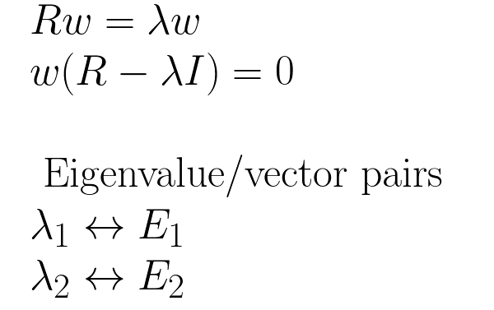
Capon Method
We are left with an eigenvalue problem.
Notes:
\\\\
Rw = \lambda w
\\
w(R-\lambda I) = 0
\\\\
\text{ Eigenvalue/vector pairs}
\\
\lambda _1 \leftrightarrow E_1
\\
\lambda _2 \leftrightarrow E_2

Slide 25
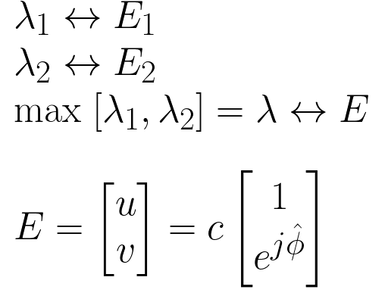
Capon Method
The maximum eigenvalue has an eigenvector that provides us with our optimal steering vector. This can be normalized, and the phase angle extracted.
Notes:
\\\\
\lambda _1 \leftrightarrow E_1
\\
\lambda _2 \leftrightarrow E_2
\\
\text{max } [\lambda_1 ,\lambda_2] = \lambda \leftrightarrow E
\\\\
E = \begin{bmatrix}
u \\ v
\end{bmatrix}
= c\begin{bmatrix}
1 \\ e^{j\hat{\phi}}
\end{bmatrix}

Slide 26
Capon Method
Calculate covariance matrix
Find maximum eigenvalue
Return the argument of the eigenvector

Slide 27
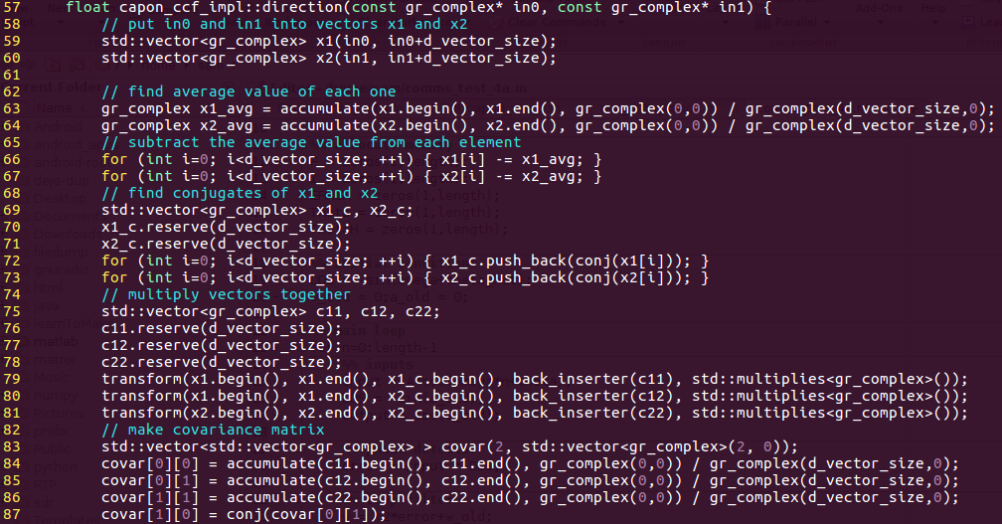
Capon Method

Slide 28
Capon Method
Analytical solution for the eigenvalue problem.
Return the argument of the eigenvector

Slide 29
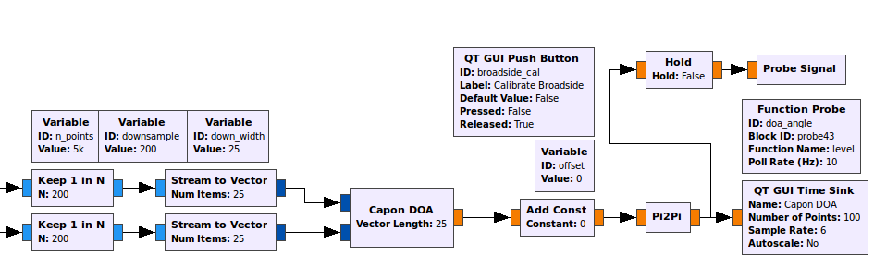
Capon Method

Slide 30
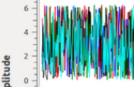
Capon Method
Our results were not clean, only in rare cases were we able to get any kind of consistent angle output.
We examined the signals, and discovered large delays between the two data streams.

Slide 31
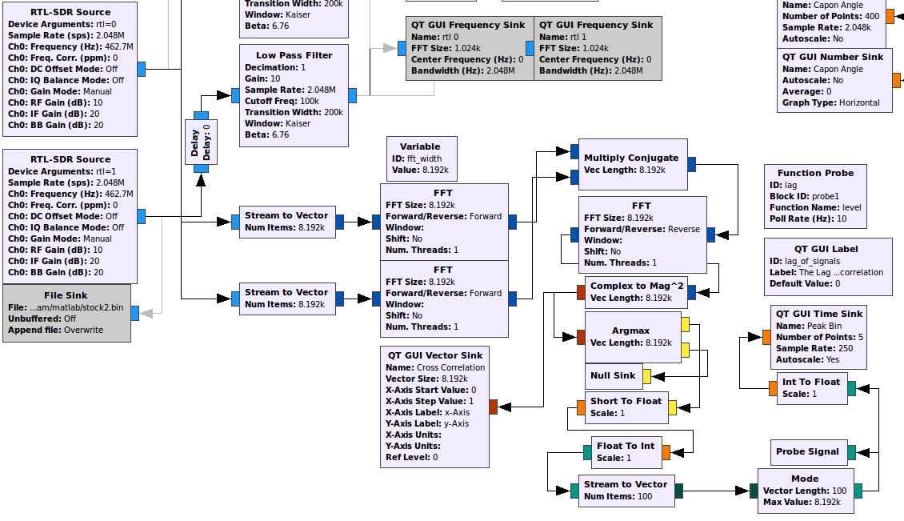
Capon Method

Slide 32
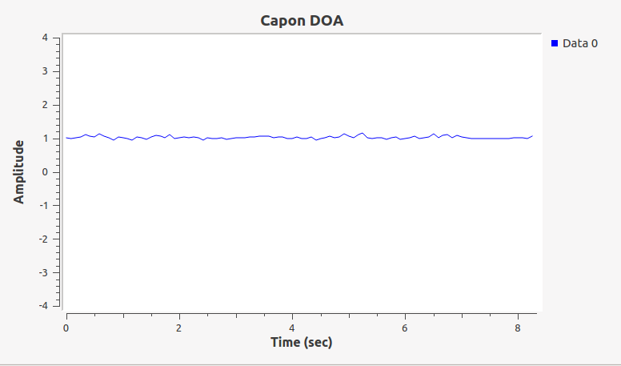
Capon Method

Slide 33
Coherency
Bulk Delay from initialization and USB
Clocks are at different frequencies
Initial Phase Offsets

Slide 34
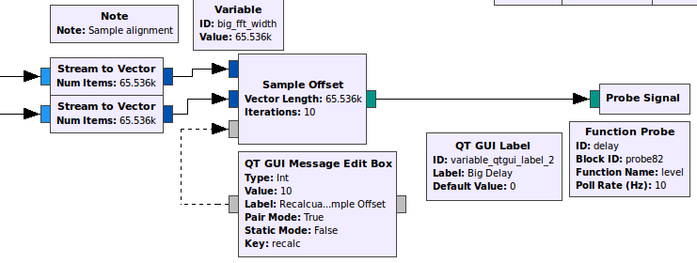
Coherency - Bulk Delay
Bulk Delays - the large offset due to the initialization of the dongles and gnuradio. Only one large correlation is needed for this.

Slide 35
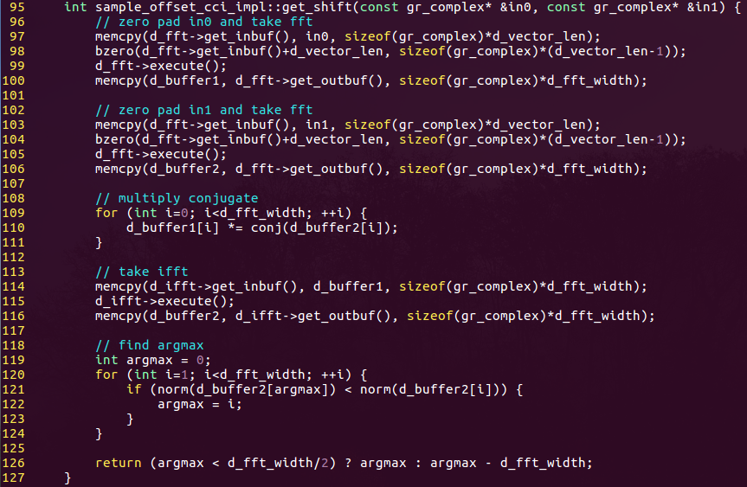
Coherency - Bulk Delay

Slide 36
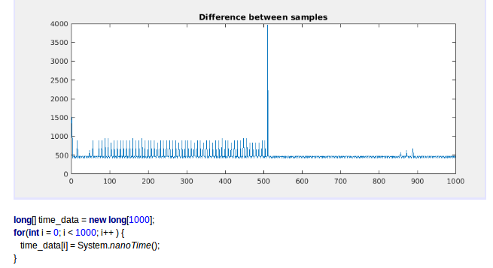
Coherency - Time Stamping

Slide 37
Coherency - Time Stamping
500 nano second gaps between calls to the clock
Jumps made the timing inconsistent
Same for native code, even at low ‘nice’ levels (high priority) on rooted phones.

Slide 38
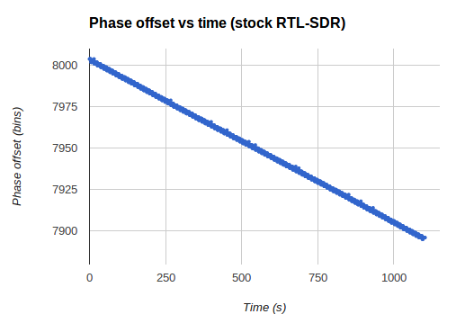
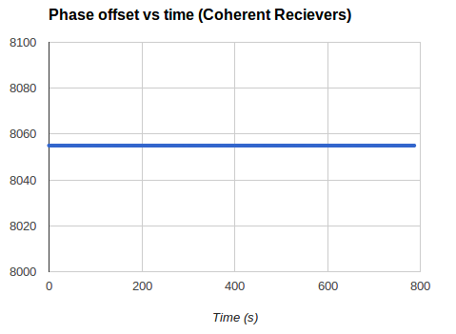
Coherency
Cross Correlation

Slide 39
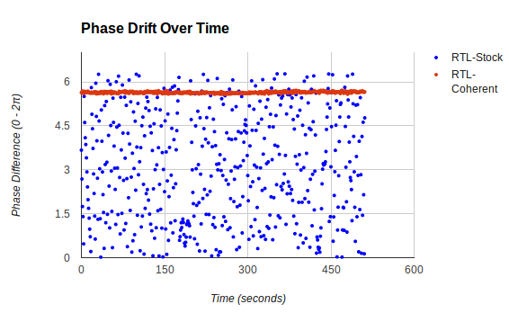
Coherency
Capon Method

Slide 40
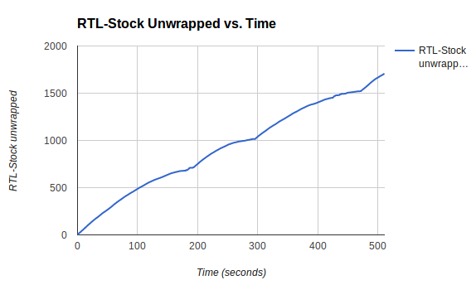
Coherency
Capon Method

Slide 41
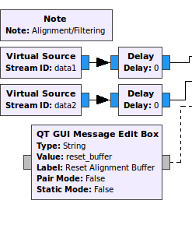
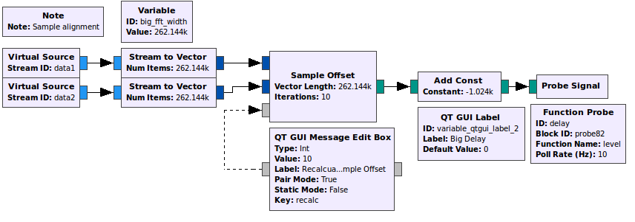
Coherency - Bulk Delay
Feedback applied
Feedback from here

Slide 42
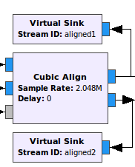
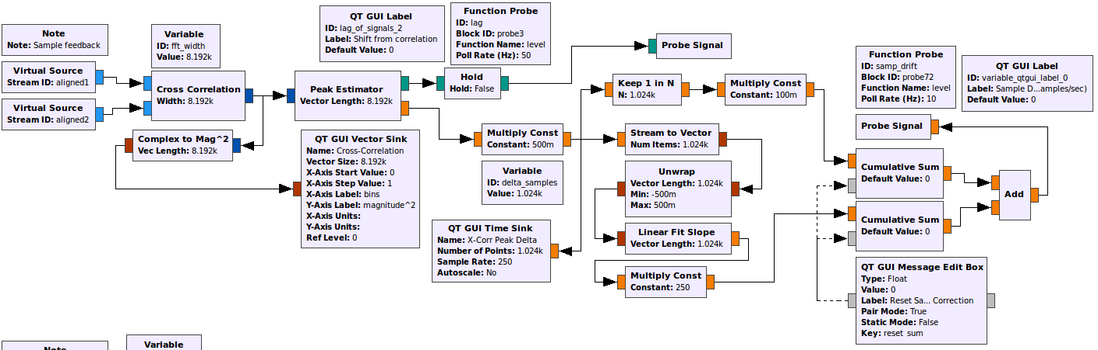
Coherency - Sample Drift
Feedback applied
Feedback from here

Slide 43
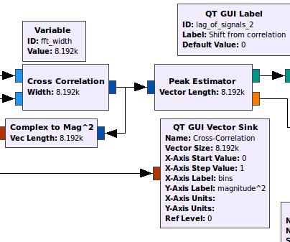
Coherency - Sample Drift
Feedback applied
Cross correlation with fractional sample peak estimation

Slide 44
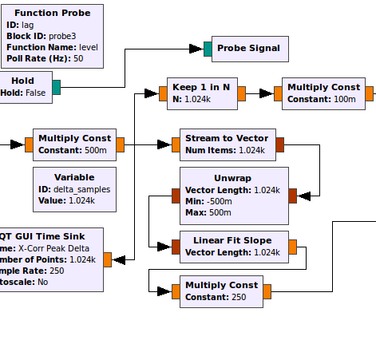
Coherency - Sample Drift
Feedback applied
Unit Conversion and scaling
Unwrapping
Linear slope approximation

Slide 45
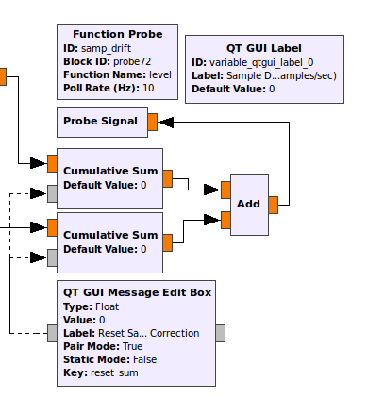
Coherency - Sample Drift
Feedback applied
Cumulative summation of the error

Slide 46
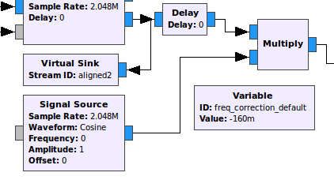
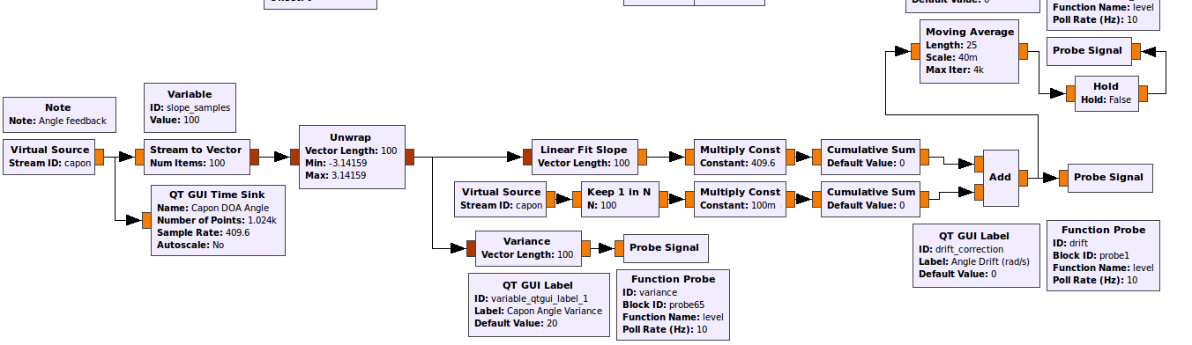
Coherency - Complex Drift
Feedback applied

Slide 47
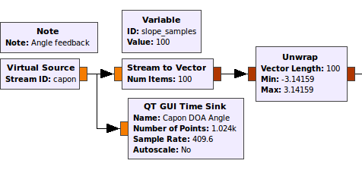
Coherency - Complex Drift
Feedback applied
Unwrap the Capon result

Slide 48
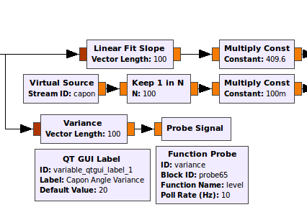
Coherency - Complex Drift
Feedback applied
Linear slope estimation
Converge to zero through a direct term

Slide 49
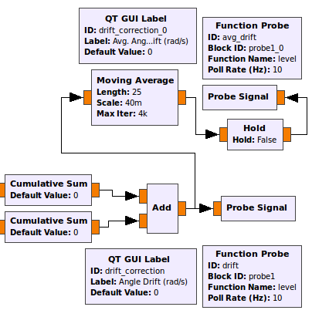
Coherency - Complex Drift
Feedback applied
Sum of the errors applied to a moving average filter.

Slide 50
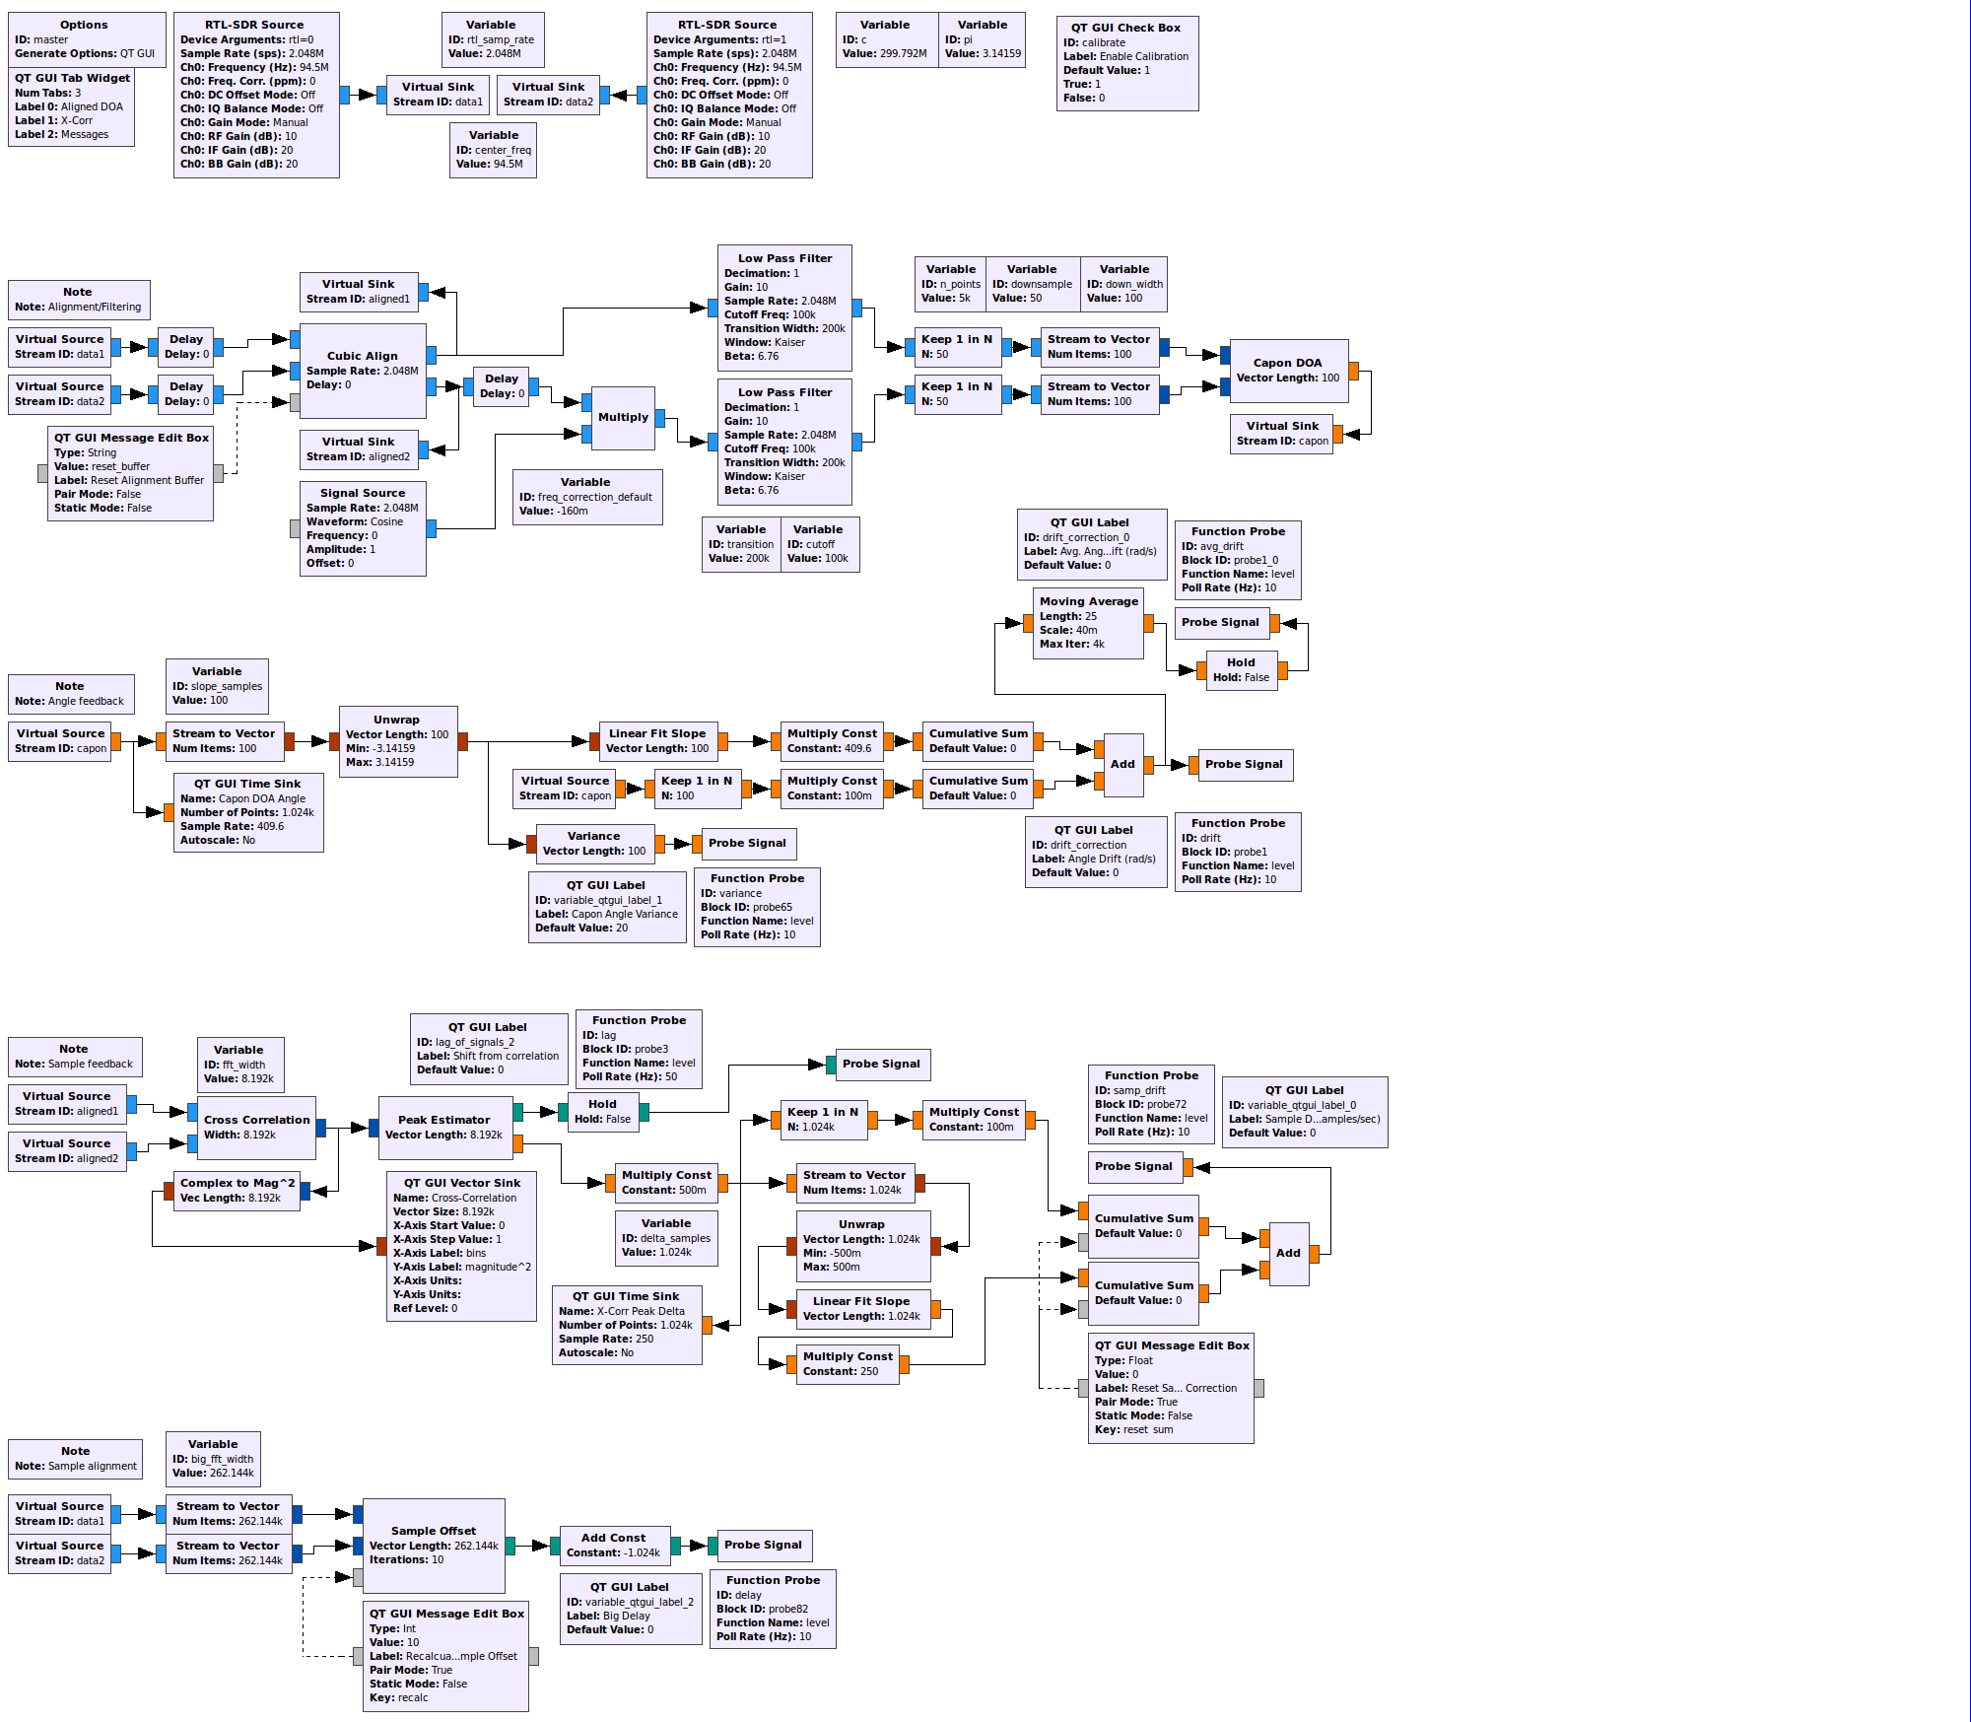
Coherency
Results in a complex flowgraph, but computationally reasonable.

Slide 51

Coherency
Sample Drift Calibration

Slide 52

Coherency
Complex Drift Calibration

Slide 53

Coherency
Calibration will ‘erase’ our beamforming results, so we need a way to enable and disable it once our signals are steady.

Slide 54
Coherency
Any temperature change ruins the calibration.

Slide 55

Coherency - Hardware

Slide 56

Coherent Receivers from coherent-receiver.com

Slide 57

What can we do with these? Simplify.

Slide 58

Single Beamformer

Slide 59

Triangulation (not what we’re doing)

Slide 60

Distributed Network of Beamformers

Slide 61

Synthetic Array of Beamformers

Slide 62
Back to Beamforming
Radial movement is changing the direction of arrival angle.

Slide 63

Full Capon 2 antennas
Minimum Variance Distortionless Response (MVDR) sets up our optimization problem slightly differently.
Introduction to Spectral Analysis,
Peter Stoica and Randolph Moses

Slide 64

Full Capon 2 antennas
Introduction to Spectral Analysis,
Peter Stoica and Randolph Moses

Slide 65

Full Capon 2 antennas
Introduction to Spectral Analysis,
Peter Stoica and Randolph Moses

Slide 66

Full Capon 2 antennas

Slide 67

Full Capon 2 antennas

Slide 68

Full Capon 2 antennas

Slide 69
Full Capon 3 antennas
With 3 antennas, we could find 2 sources at the same time. This could help us identify problems such as multi-path.
This requires us to make and invert a 3x3 covariance matrix, which is more complex.

Slide 70

Full Capon 3 antennas

Slide 71

Full Capon 3 antennas

Slide 72

Full Capon 3 antennas: luDecomp()

Slide 73

Full Capon 3 antennas: luDecomp()

Slide 74

Full Capon 3 antennas: invert_lower()

Slide 75

Full Capon 3 antennas: invert_upper()

Slide 76

Full Capon 3 antennas

Slide 77

Full Capon 3 antennas

Slide 78

Full Capon 3 antennas

Slide 79
All Capon Methods

Slide 80

Capon and Phase Subtraction

Slide 81
Challenges
2 USB connections in Android App
Pass data between gnuradio(c++) and Java
Function probe in c++ (feedback)
Distributed nodes
Radial Movement, changing phase

Slide 82
Auxiliary Slides

Slide 83

Antenna Geometry
Spatial sampling at nyquist means we need to sample every ½ wavelength

Slide 84
RTL-SDR specs from RTL-SDR.com
Rafael Micro R820T Frequency Range: 24 – 1766 MHz
The maximum sample rate that does not drop samples is 2.4 MS/s
The native resolution is 8 bits
Since these dongles are intended for TV, all dongles will have an input impedance of about 75 Ohms. However, the mismatch loss when using 50 Ohm cabling will be very minimal at around 0.177 dB.
1 PPM temperature compensated oscillator

Slide 85
Coherency (synchronization)
Calibrate two different dongles
cross correlation
fractional sample cross correlation
sample interpolation
frequency offset with complex exponentials
Hardware
Common Clock
GPS PPS
Higher Precision Oscillator

Slide 86

A Single Node in the System:

Slide 87


B200 Mini - ettus.com
Alternative to RTL-SDR dongle
$700

Slide 88
Calibration

Slide 89

Assumptions - Far Field

Slide 90

Assumptions - Narrow Band
1/19/2017 - Sant Building with RTL-SDR

